Slide 1
CREDIT EDA CASE STUDY ANALYSIS
Presented By:-
Rohan Kishore Sharma
Nilesh Kumar Ghavaria

Slide 2
Objective of Case Study
To analyze the univariate and bivariate variations in the data of loan applicants.
Taking consideration of the customers current application.
Also taking consideration of the customers current as well as previous application combined to analyze pattern.
Find the data imbalance between the customers data provided in both the case.

Slide 3
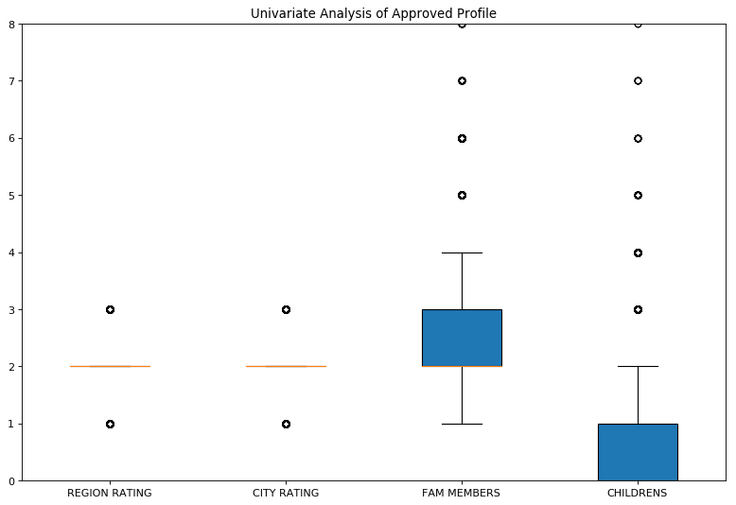
UNIVARIATE ANALYSIS OF APPROVED PROFILES

Slide 4

UNIVARIATE ANALYSIS OF REJECTED PROFILES

Slide 5
EXPLANATION
As we can clearly see from the above graphs. There seems to be no such pattern observed with these 4 parameters of an application.
It is observed that both the graphs has equal mean and variations has there 4 parameters has no impact on the customers profile.
Hence we have to analyze some more patterns between other variables to find some correlation.
Kindly note Approved profile means profile with No payment difficulty and vise versa.

Slide 6
DATA IMBALANCE PERCENTAGE
From the provided data with the current applications.
We have following percentages.
Data with no payment difficulties are around 91.93%
Whereas data with payment difficulties are around 8.07%

Slide 7
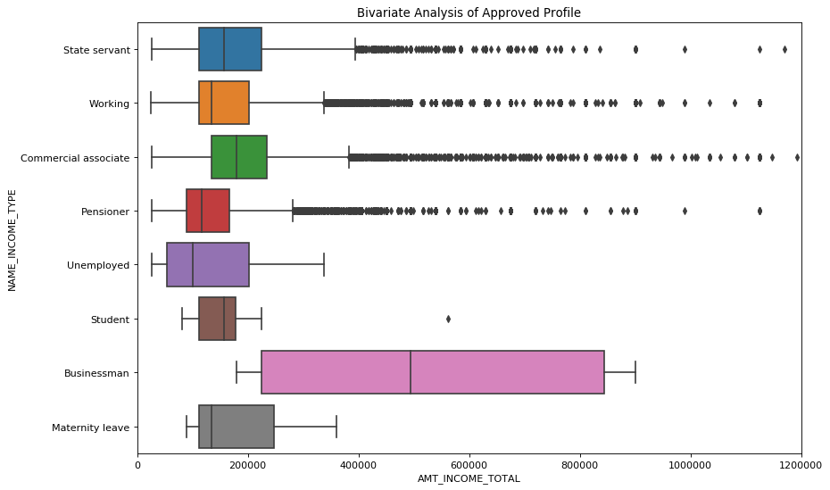
BIVARIATE ANALYSIS OF APPROVED PROFILES

Slide 8
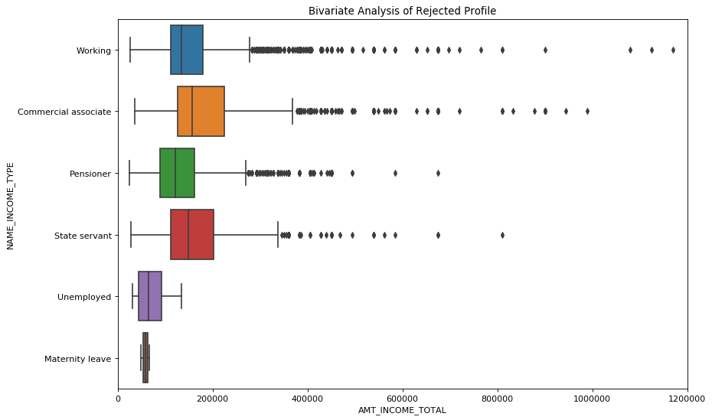
BIVARIATE ANALYSIS OF REJECTED PROFILES

Slide 9
EXPLANATION
As we can clearly see the box plot of the various sources of Incomes of the client.
Below are few of the observations.
For example if we take into consideration the application of client having source of income as maternity leave.
It is observed that client having income around 1,00,000 to 2,50,000 are more likely that the application will be approved.
Whereas for the client having income around 50,000 to 60,000 are more likely that the application will be rejected.
Also if we look at the clients having source of Income as state servant we are able to find some outliers in the Dataset.
There are clients in the dataset which has Income as 4,00,000 and as seen in the 1st graph the application has been approved.
Whereas if we take look at the other data set the same application with same Income has been rejected.

Slide 10
POST TAKING PREVIOUS DATA AS WELL INTO CONSIDERATIONS.
HERE ARE SOME OF THE OBSERVATIONS.

Slide 11
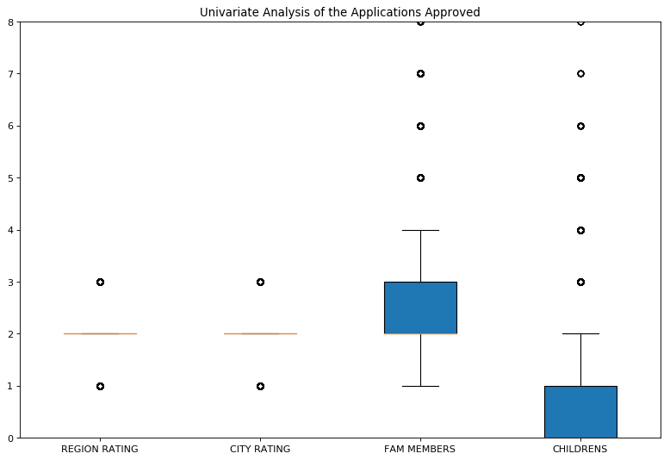
UNIVARIATE ANALYSIS OF APPROVED PROFILES

Slide 12

UNIVARIATE ANALYSIS OF REJECTED PROFILES

Slide 13
EXPLANATION
As we can clearly see from the above graphs. There seems to be no such pattern observed with these 4 parameters of an application.
It is observed that both the graphs has equal mean and variations has there 4 parameters has no impact on the customers profile even if customers past applications has been considered.
Hence we have to analyze some more patterns between other variables to find some correlation.

Slide 14
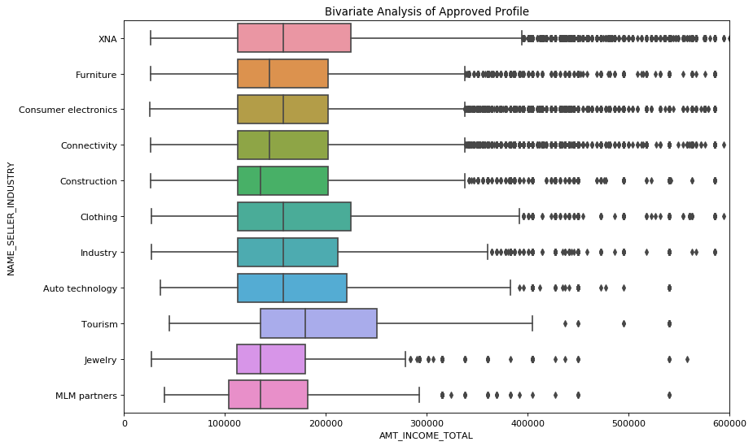
BIVARIATE ANALYSIS OF APPROVED PROFILES

Slide 15
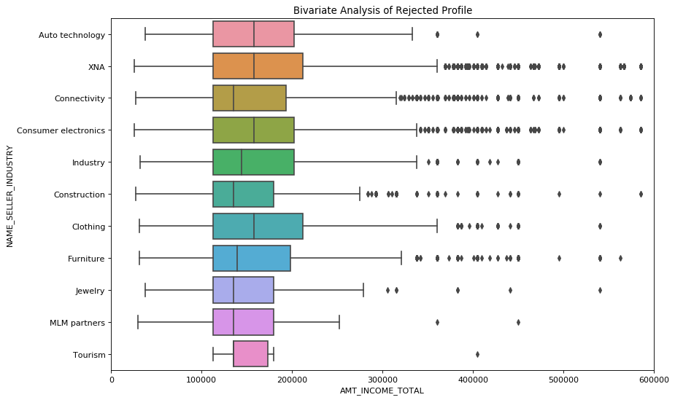
BIVARIATE ANALYSIS OF REJECTED PROFILES

Slide 16
EXPLANATION
As we can clearly see the box plot of the various sources of Incomes of the client.
Below are few of the observations.
For example if we take into consideration the application of client having source of income as Tourism.
It is observed that client having income around 1,50,000 to 1,80,000 are more likely that the application will be rejected.
Whereas for the client having income around 1,50,000 to 2,50,000 are more likely that the application will be rejected. The spread for this box is wide spread.

Slide 17
EXPLANATION cont..
Hence signifies that there are huge variations in the data when taken consideration of the customers previous data.
Also if we look at the clients having source of Income as Furniture we are able to find huge outliers in the Dataset.
Where in the customers has huge amount of income as a source but some applications are approved and rejected as well if taking 4,00,000 to 5,00,000 bracket as an amount.
There are clients in the dataset which has Income as 4,00,000 and as seen in the 1st graph the application has been approved.
Whereas if we take look at the other data set the same application with same Income has been rejected.

Slide 18
DATA IMBALANCE PERCENTAGE
From the provided data with the current applications along with the previous application of the customer.
We have following percentages.
Data with no payment difficulties are around 91.38%
Whereas data with payment difficulties are around 8.62%

Slide 19
THANK YOU…!!!

